Slide 1
Java Database Connectivity

Slide 2
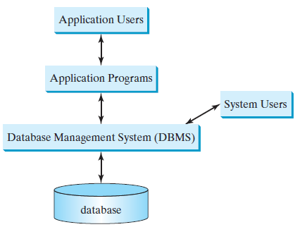
JDBC
Database System: A database system consists of a database, the software that stores and manages data in the database, and the application programs.
Fig: A database system
Database: A database is a repository of data that form information.
Most of today’s database systems are relational database systems. They are based on the relational data model, which has three key components: structure, integrity, and language.

Slide 3
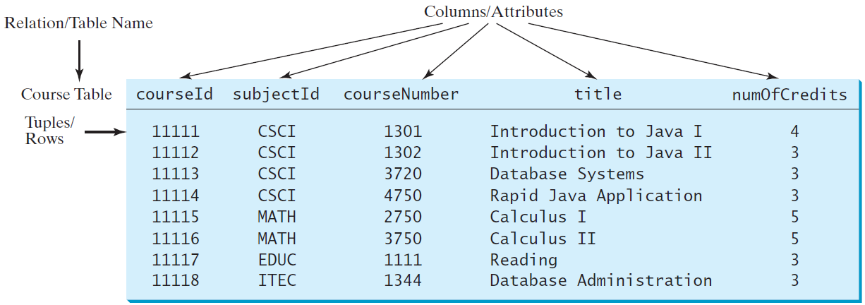
JDBC
Structure defines the representation of the data. Integrity imposes constraints on the data. Language provides the means for accessing and manipulating data.
Relational Structure: A relation is actually a table that consists of nonduplicate rows. Tables are easy to understand and use.
A row of a table represents a record, and a column of a table represents the value of a single attribute of the record.
In relational database theory, a row is called a tuple and a column is called an attribute.

Slide 4
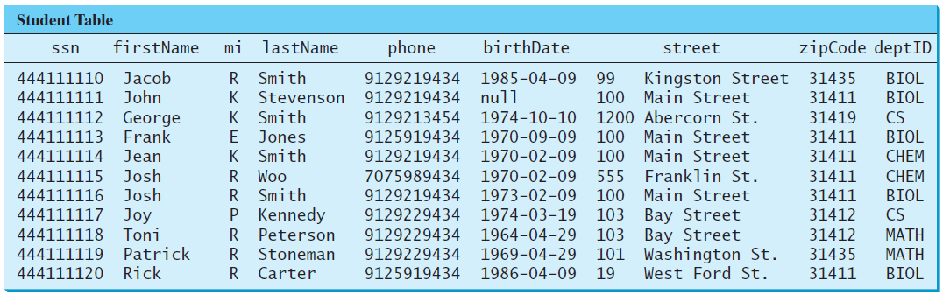
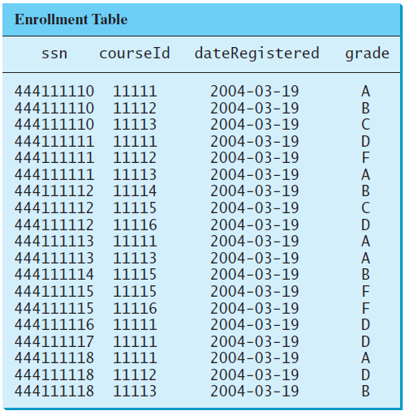
JDBC
Student table and Enrollment table are as follows:

Slide 5
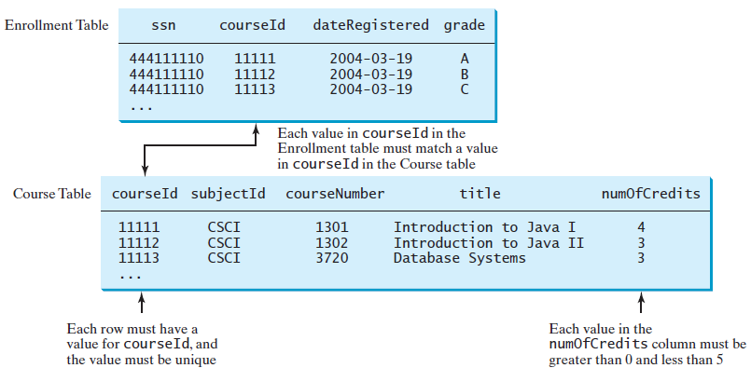
JDBC
Integrity Constraints: An integrity constraint imposes a condition that all the legal values in a table must satisfy. Fig. shows an example of some integrity constraints in the Enrollment and Course tables.

Slide 6
JDBC
Domain Constraints: Domain constraints specify the permissible values for an attribute. Domains can be specified using standard data types, such as integers, floating-point numbers, fixed-length strings, and variant-length strings.
Primary Key Constraints:
To understand primary keys, we should know superkeys, keys, and candidate keys.
A superkey is an attribute or a set of attributes that uniquely identifies the relation. That is, no two tuples have the same values on a superkey.

Slide 7
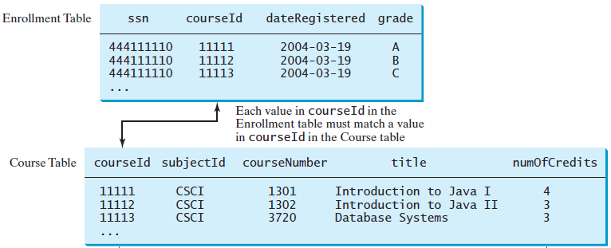
JDBC
Primary Key Constraints:
A key K is a minimal superkey, meaning that any proper subset of K is not a superkey.
A relation can have several keys. In this case, each of the keys is called a candidate key.
The primary key is one of the candidate keys designated by the database designer.
The primary key is often used to identify tuples in a relation. courseId is the primary key in the Course table as shown previously.

Slide 8
JDBC
Foreign Key Constraints: Informally speaking, the common attributes are foreign keys. The foreign key constraints define the relationships among relations.
Formally, a set of attributes FK is a foreign key in a relation R that references relation T if it satisfies the following two rules:
■ The attributes in FK have the same domain as the primary key in T.
■ A nonnull value on FK in R must match a primary key value in T.
As shown in Figure 32.6, courseId is the foreign key in Enrollment that references the primary key courseId in Course. Every courseId value must match a courseId value in Course.

Slide 9
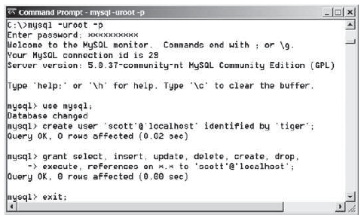
JDBC
Structured Query Language (SQL): SQL is the language for defining tables and integrity constraints, and for accessing and manipulating data. MySQL is an example of the SQL.
Creating a User Account on MySQL
Let us create a user named scott with the password tiger. Here are the steps to create a user from the command line:
1. From the DOS command
prompt, type
mysql –uroot -p
You will be prompted to enter
the root password, as shown
in Fig.
2. At the mysql prompt, enter
use mysql;

Slide 10
JDBC
Creating a User Account on MySQL
3. To create user scott with password tiger, enter
create user 'scott'@'localhost' identified by 'tiger';
4. To grant privileges to scott, enter
grant select, insert, update, delete, create, create view, drop,
execute, references on *.* to 'scott'@'localhost';
5. Enter
exit;
to exit the MySQL console.

Slide 11
JDBC
Creating a Database
Lets consider a database named javabook. Here are the steps to create it:
1. From the DOS command prompt, type
mysql –uscott -ptiger
to login to mysql, as shown in Fig.
2. At the mysql prompt, enter
create database javabook;

Slide 12
JDBC
Creating a Database
To execute the script, first switch to the javabook database using the following command:
use javabook;
and then type
source script.sql;
as shown in Fig.

Slide 13
JDBC
Creating and Dropping Tables
Tables are the essential objects in a database. To create a table, use the create table statement to specify a table name, attributes, and types, as in the following example:
create table Course (
courseId char(5),
subjectId char(4) not null,
courseNumber integer,
title varchar(50) not null,
numOfCredits integer,
primary key (courseId)
);

Slide 14
JDBC
Creating and Dropping Tables
The tables Student and Enrollment can be created as follows:
create table Student (
ssn char(9),
firstName varchar(25),
mi char(1),
lastName varchar(25),
birthDate date,
street varchar(25),
phone char(11),
zipCode char(5),
deptId char(4),
primary key (ssn)
);
create table Enrollment (
ssn char(9),
courseId char(5),
dateRegistered date,
grade char(1),
primary key (ssn, courseId),
foreign key (ssn) references
Student(ssn),
foreign key (courseId) references
Course(courseId)
);

Slide 15
JDBC
Creating and Dropping Tables
To delete table and database
drop table Course;
drop database javabook;

Slide 16
JDBC
Simple Insert, Update, and Delete
The syntax to insert a record into a table is:
insert into tableName [(column1, column2, ..., column)]
values (value1, value2, ..., valuen);
Example:
insert into Course (courseId, subjectId, courseNumber, title, numOfCredits)
values ('11113', 'CSCI', '3720', 'Database Systems', 3);
The column names are optional.

Slide 17
JDBC
Simple Insert, Update, and Delete
The syntax to update a table is:
update tableName
set column1 = newValue1 [, column2 = newValue2, ...]
[where condition];
Example: The following statement changes the numOfCredits for the course whose title is Database Systems to 4.
update Course
set numOfCredits = 4
where title = 'Database Systems';

Slide 18
JDBC
Simple Insert, Update, and Delete
The syntax to delete records from a table is:
delete from tableName
[where condition];
Example: The following statement deletes the Database Systems course from the Course table:
delete from Course
where title = 'Database Systems';
The following statement deletes all the records from the Course table:
delete from Course;

Slide 19
JDBC
Simple Queries:
To retrieve information from tables, use a select statement with the following syntax:
select column-list
from table-list
[where condition];
Query 1: Select all the students in the CS department, as shown in Fig.
select firstName, mi, lastName
from Student
where deptId = 'CS';

Slide 20
JDBC
Simple Queries:
Query 2: Get the names of the students who are in the CS dept and live in the ZIP code 31411.
select firstName, mi, lastName
from Student
where deptId = 'CS' and zipCode = '31411’;

Slide 21
JDBC
Column Alias
Syntax
select columnName [as] alias
Query 4: Get the last name and ZIP code of the students with “CS” department and column headings as “Last Name” for lastName and “Zip Code” for zipCode.
select lastName as "Last Name", zipCode as "Zip Code"
from Student
where deptId = 'CS';

Slide 22
JDBC
JDBC
The Java API for developing Java database applications is called JDBC. JDBC provides Java programmers with a uniform interface for accessing and manipulating relational databases.
Using the JDBC API, applications written in the Java programming language can execute SQL statements, retrieve results, present data in a user-friendly interface, and propagate changes back to the database.
The JDBC API can also be used to interact with
multiple data sources in a distributed, heterogeneous environment.

Slide 23
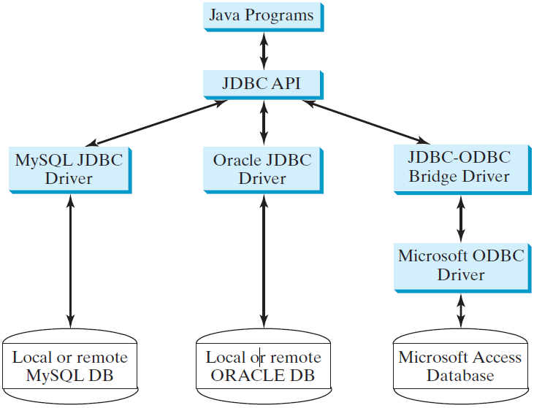
JDBC
JDBC
The relationships between Java programs, JDBC API, JDBC drivers, and relational databases are shown in Fig. The JDBC API is a set of Java interfaces and classes used to write Java programs for accessing and manipulating relational databases.

Slide 24
JDBC
Developing Database Applications Using JDBC
The JDBC API consists of classes and interfaces for establishing connections with databases, sending SQL statements to databases, processing the results of SQL statements, and obtaining database metadata.
Four key interfaces are needed to develop any database application
using Java: Driver, Connection, Statement, and ResultSet. These interfaces define a framework for generic SQL database access.
The JDBC API defines these interfaces, and the JDBC driver vendors provide the implementation for the interfaces. Programmers use
these interfaces.

Slide 25
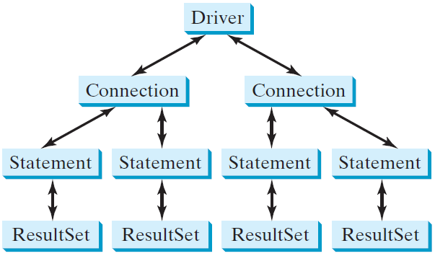
JDBC
Developing Database Applications Using JDBC
The relationship of these interfaces is shown in following Fig.
A JDBC application loads an appropriate driver using the Driver interface, connects to the database using the Connection
interface, creates and executes SQL statements using the Statement interface, and processes the result using the ResultSet interface if the statements return results.

Slide 26
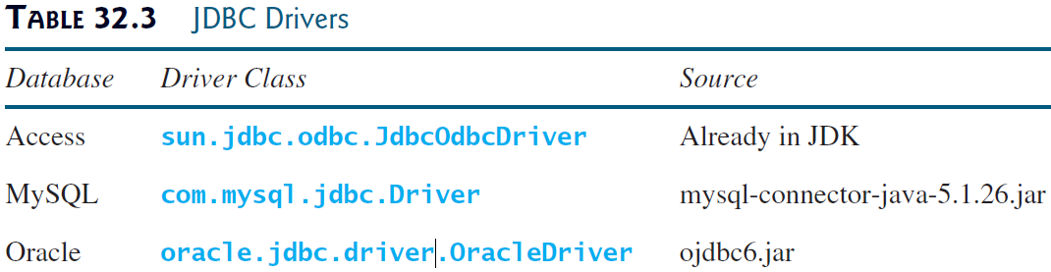
JDBC
Developing Database Applications Using JDBC
A typical Java program takes the following steps to access a database.
1. Loading drivers.
An appropriate driver must be loaded using the statement shown below before connecting to a database.
Class.forName("JDBCDriverClass");
A driver is a concrete class that implements the java.sql.Driver interface. The drivers for Access, MySQL, and Oracle are listed in following Table:

Slide 27
JDBC
Developing Database Applications Using JDBC
To use the MySQL and Oracle drivers, we need to add mysql-connector-java-5.1.26.jar and ojdbc6.jar in the classpath using the following DOS command on Windows:
set classpath=%classpath%;c:\book\lib\mysql-connector-java-5.1.26.jar;
c:\book\lib\ojdbc6.jar
If you use an IDE such as Eclipse or NetBeans, you need to add these jar files into the library in the IDE.

Slide 28
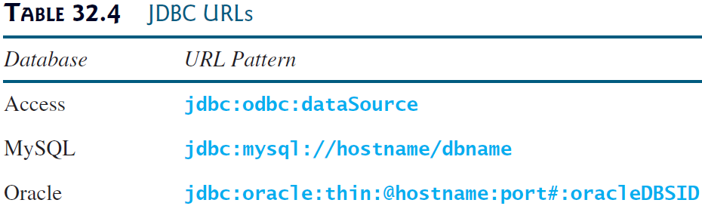
JDBC
Developing Database Applications Using JDBC
2. Establishing connections.
To connect to a database, use the static method getConnection(databaseURL) in the DriverManager class, as follows:
Connection connection = DriverManager.getConnection(databaseURL);
where databaseURL is the unique identifier of the database on the Internet. Table 32.4 lists the URL patterns for the Access, MySQL, and Oracle databases.

Slide 29
JDBC
Developing Database Applications Using JDBC
The databaseURL for a MySQL database specifies the host name and database name to locate a database. For example, the following statement creates a Connection object for the local MySQL database javabook with username scott and password tiger:
Connection connection = DriverManager.getConnection
("jdbc:mysql://localhost/javabook", "scott", "tiger");

